Slide 1
Strand 4: computational thinking
Sub-strand 3: robotics

Slide 2
Robotics
Robot is a machine programmable by a computer that is capable of carrying out complex tasks automatically. Robots can be guided by external device or the control may be embedded within. Robots may be constructed based on human form but most robots are machine design to perform a task. Robots perform repetitive tasks that are sometimes dangerous to be perform by humans.

Slide 3
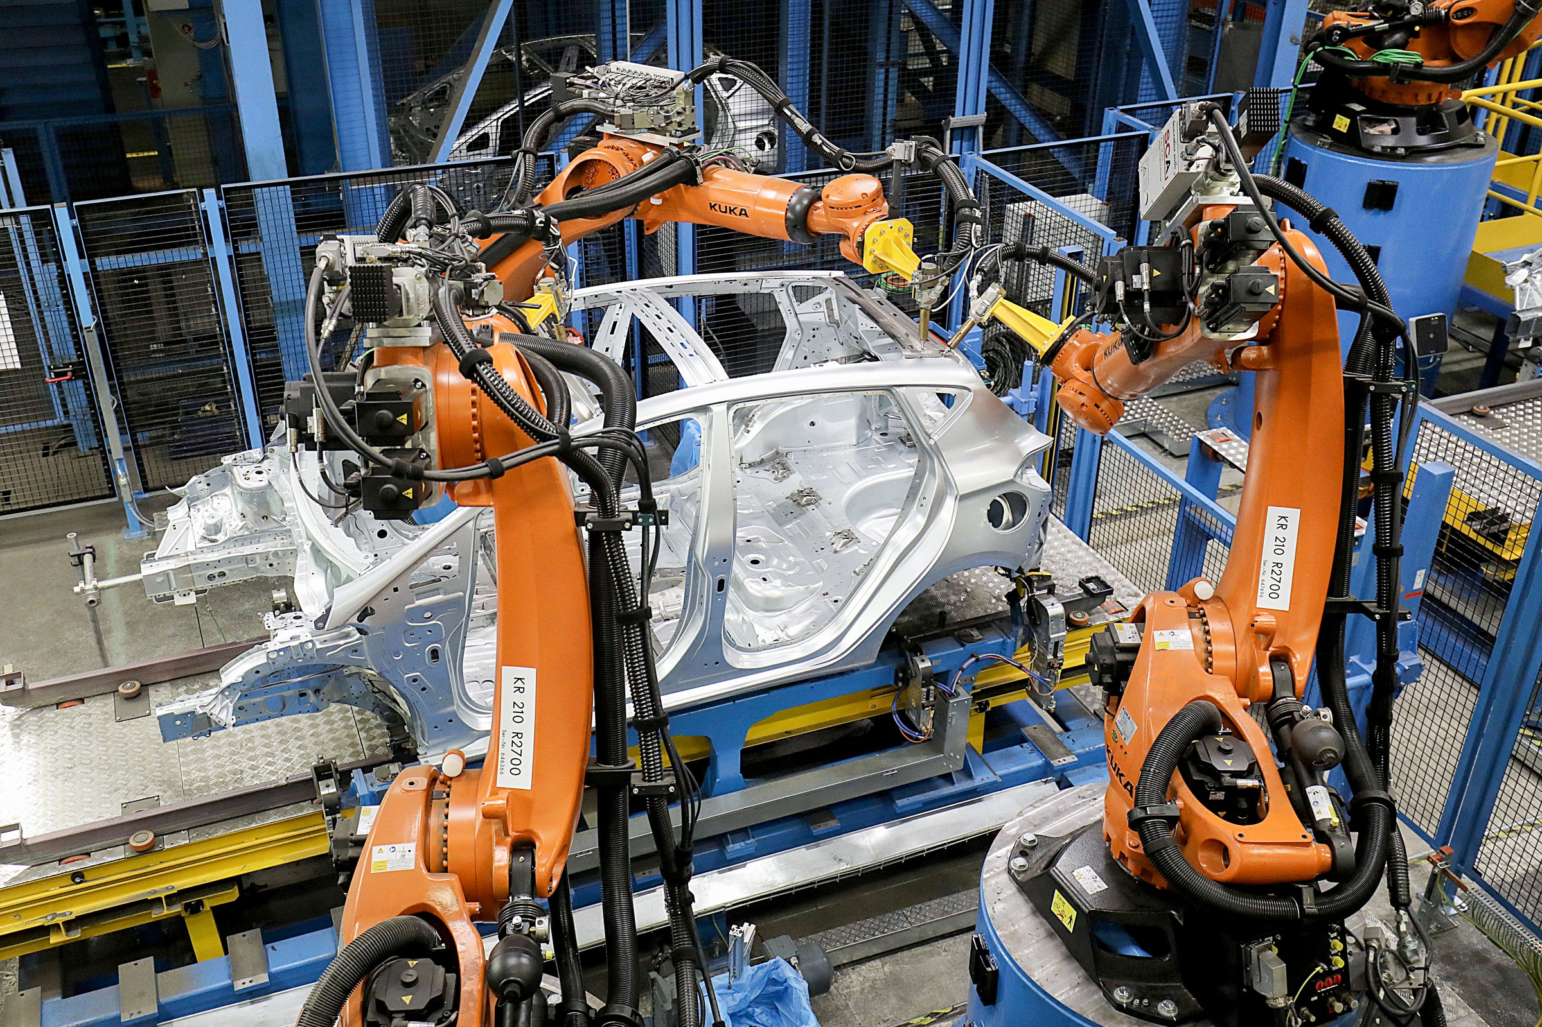
Robots in manufacturing plant

Slide 4
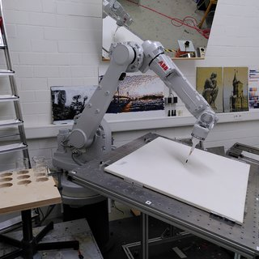
Robots regarding paiting

Slide 5
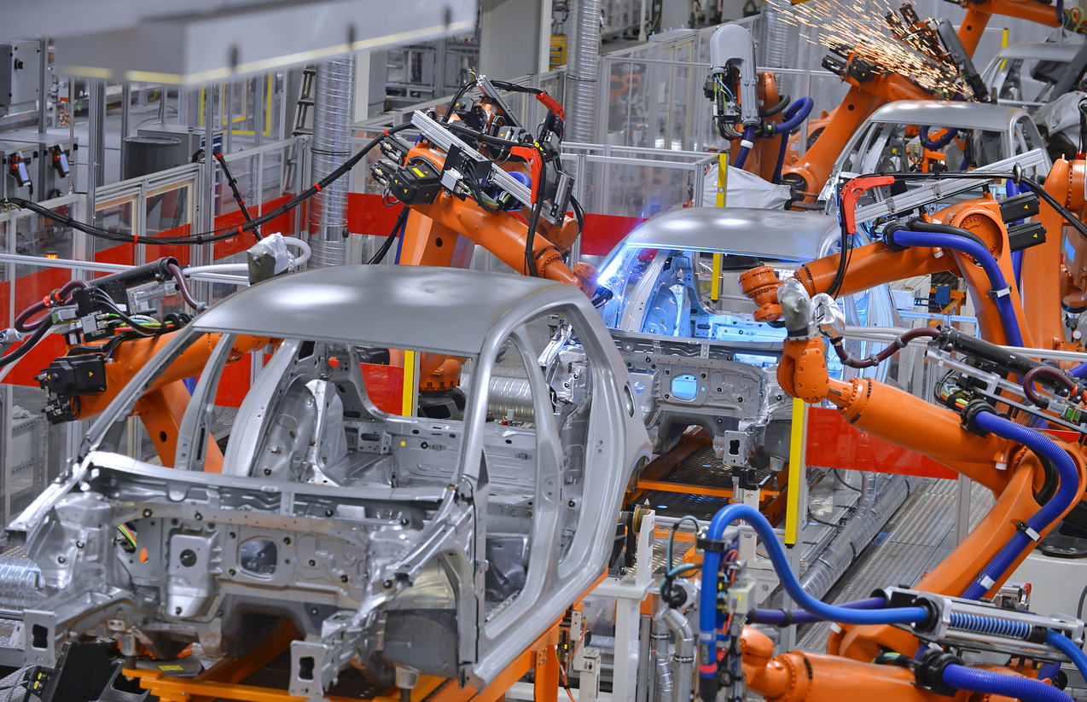
Robots assembling cars in an automobile assembly plant

Slide 6
Types of robots
Fixed robots: The fixed robotics are stationary robots that solve or help in problem solving in being at one position.
The mobile robotics is a movable robot that are able to move around their environment using wheels or legs.

Slide 7
Uses Of Robots In The Society
Education: Robots are used now in classroom for learning and teaching purposes and extra curriculum activities. Robots are used to increase students interest in Science, Technology, Engineering and Mathematics (STEM).
Educational robotics strengthen and support students skills by developing their knowledge through creation, design, assembly, and operation of robots.

Slide 8
Uses Of Robots In The Society
Agriculture: In farming where we use hand in tilling, harvesting, weeding. This manual way of framing is gradually being reduced or erased due to development of robots that can handle difficult tiring tasks in the farm. There are robots that have been developed for weeding. For instance, there robots that can take over thining out of seedling in the farm.

Slide 9
Uses Of Robots In The Society
Military: In the military, the army uses more robots in their activities combating rebels and searching environment for oncoming attacks. The military uses drones in battlefield and also checks on colleagues in trouble in a battle amrmed bot are also used by military. Some robots are used to carry military supply.

Slide 10
Uses Of Robots In The Society
Manufacturing: An industry robot is a robot used in manufacturing, robots work in accuracy, speed and durable way. Robots in manufacturing can work 24 hoursa without any mistake.
Robots in manufacturing are used in paniting, assembly of cars, welding in industry, material removal, material handing, packing of products and many other complex activites.

Slide 11
Uses Of Robots In The Society
Health: Robots are used in areas of health, in hospitals, medicine production, health delivery, surgery etc. In medicine production, robots developed are there to mix good and accurate medicine to avoid much error from human.
Robots in libraries : Robots have been developed for libraries which can search for books shelves with their titles and reduce the work load for libraries search of books in shelves. These robots help in the sorting of books and can navigates itself even if bthe library even if the library is not in working hours.

Slide 12
Uses Of Robots In The Society
Taking Pictures or video: some robots are developed to take pictures of people, events and anything without any mistake.
A drone taking picture/ video

Slide 13
Advantagesof using robots
Robots increase productivity, safety, efficiency, quality and consistency of products.
Robots can work in hazardous environments.
Robots need no environmental comfort such as air or lighting to work.
Robots work continuously without experiencing fatigue.
Robots have repeatable precision at all times.
Robots can be much accurate than humans.
Robots can process multiple tasks simultaneously.

Slide 14
Challenges.
Technologists have come out with seven challenges.
Robots replace human workers creating economic problems.
Robots are costly.
They break down and may not work for days, weeks or months.
A lot of time and money is spending on creating new robots to replace out dated ones.
They cannot do things they are not designed to do.
They increase the unemployment rate.
They produce a lot of electronic waste.

