Slide 1
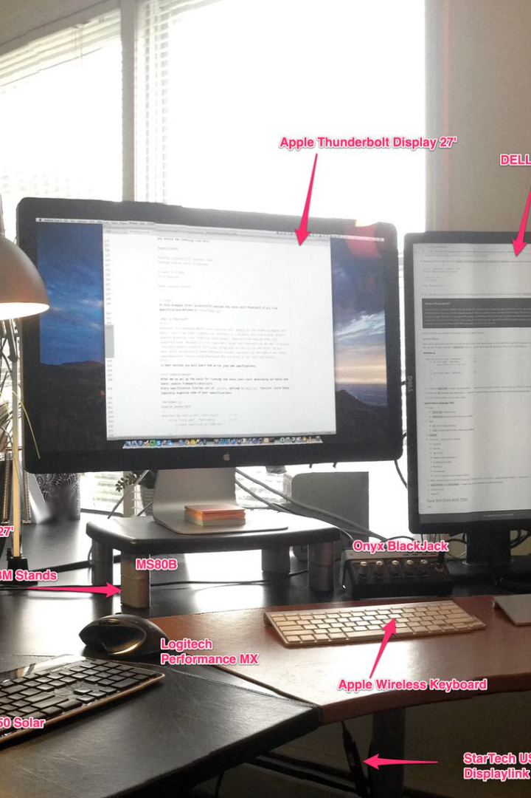

Introduction to Programming
In this presentation, we'll explore what programming is, why it's important, and how to get started.
by Nicholas Akakpo

Slide 2

What is Programming?
1
Problem Solving 🤔
2
Creating Software 🖥️
Using instructions to solve complex problems and automate tasks.
Writing code to create software applications used by millions of people.
3
Logical Thinking 🔍
Breaking down problems into manageable steps and organizing code for efficiency.

Slide 3
Why Learn Programming?
High Demand 💼
Creative Outlet 🎨
Problem Solving Skills 🤓
Programming jobs are in high demand and offer competitive salaries with room for growth.
Programming is a creative process where you can bring your ideas to life.
Learning to code helps develop critical thinking and problem solving skills.

Slide 4
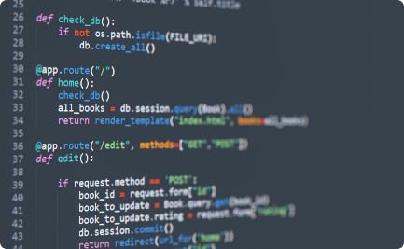
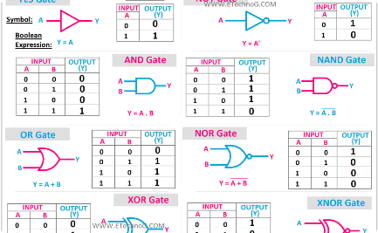
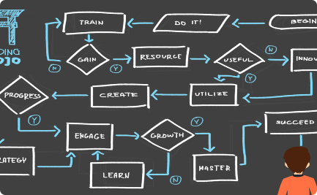
Basic Programming Concepts
Syntax
Logic
Algorithms
The set of rules and guidelines for writing code in a specific programming language.
The ability to reason and make decisions based on certain conditions.
A set of instructions to solve a specific problem.

Slide 5
Programming Languages
JavaScript
Python
Used for creating dynamic web applications and building complex front-end interfaces.
A general-purpose language used for web development, data analysis, and artificial intelligence.
C++
Ruby
A powerful language used for creating high-performance applications and games.
A versatile language used for web development, scripting, and automation.

Slide 6
Tools for Programming
Integrated Development Environment (IDE)
A more advanced tool used for debugging, testing, and deploying code.
1
2
3
Text Editor
Version Control
A basic tool used for writing simple code with syntax highlighting features
A system to keep track of changes to your code and collaborate with team members.

Slide 7



Career Opportunities in Programming
Developer
Data Scientist
Web Developer
Designing and creating software applications and programs.
Analyzing data to derive insights and inform business decisions.
Creating and maintaining websites and web applications.

Slide 8

Closing Remarks
Programming is a skill that can benefit anyone, regardless of background or career.
Start small and build up your skills over time.
Remember, practice makes perfect!

