Slide 1
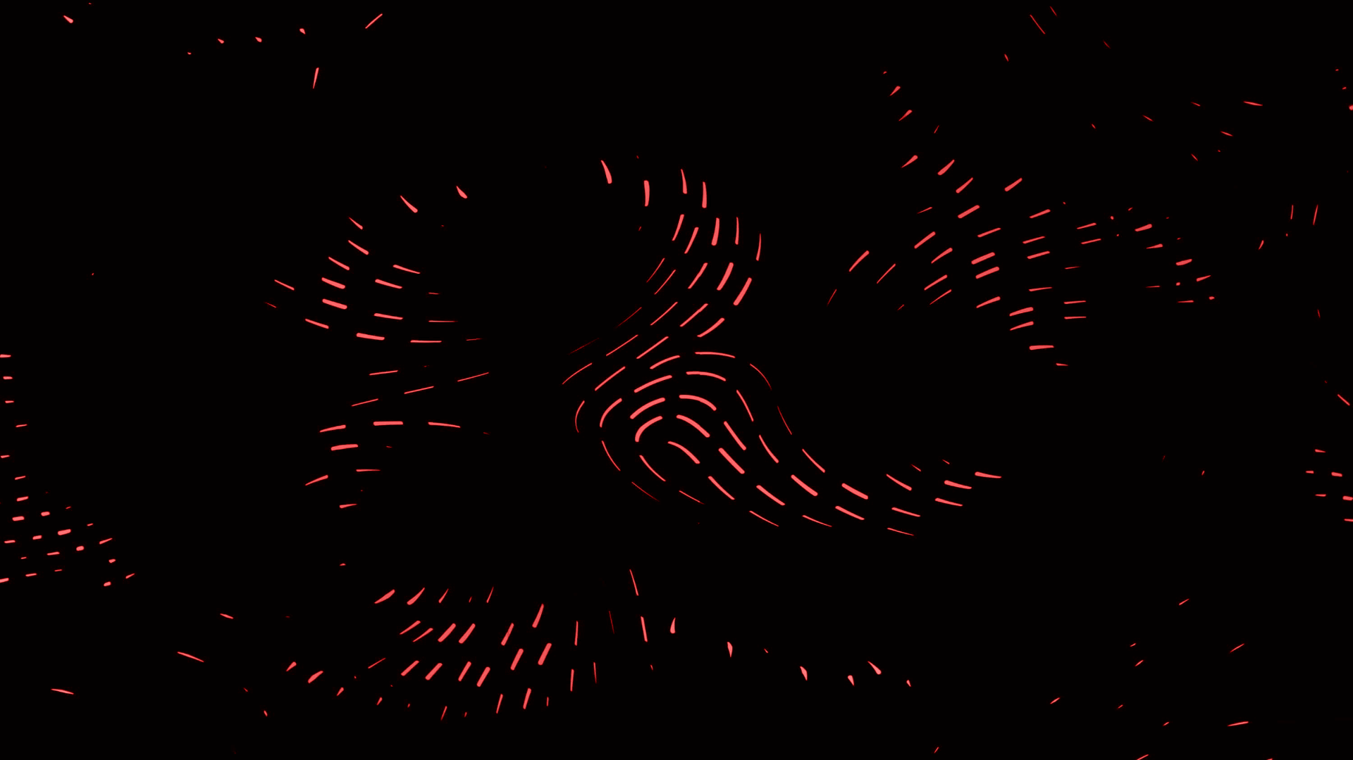
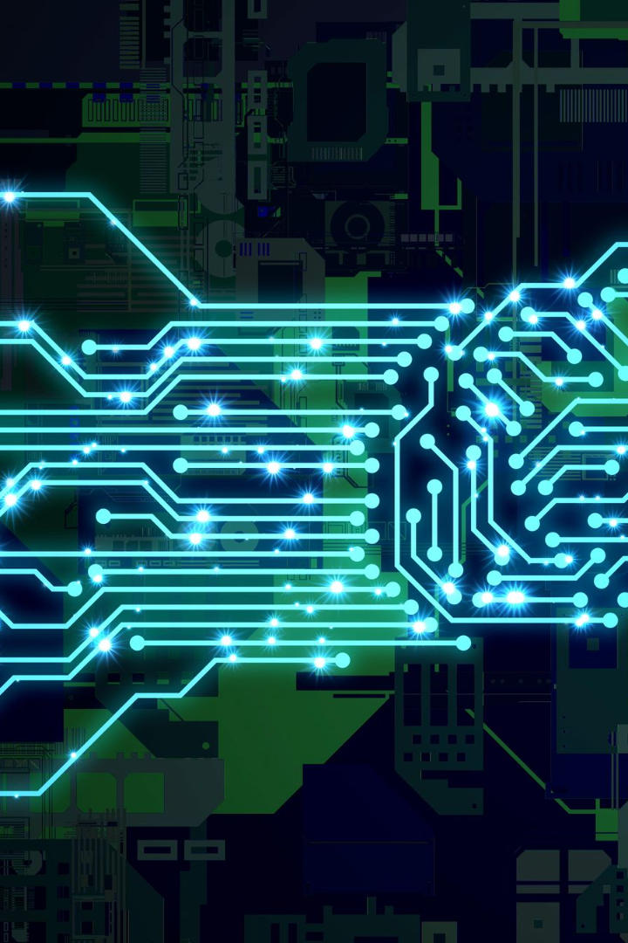

Artificial Intelligence
Artificial Intelligence (AI) is a branch of computer science that focuses on creating machines that can perform tasks that would require intelligence if done by humans.
by Nicholas Akakpo

Slide 2
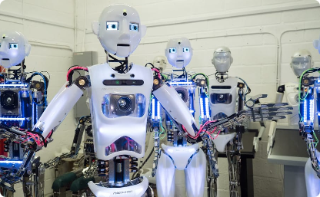
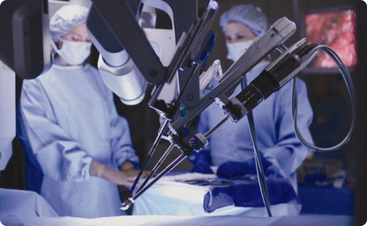
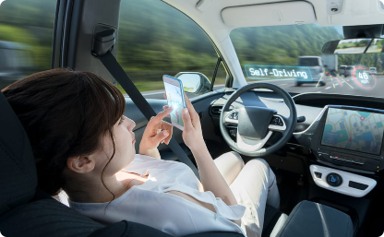
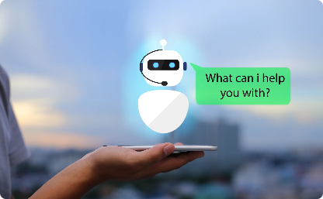
Applications of AI
Manufacturing
Healthcare
AI is used to optimize production by predicting weather conditions that may impact the supply chain and automating processes.
AI has assisted in speeding up diagnoses through predictive modeling and virtual nursing assistants.
Transport
Customer Service
Self-driving vehicles powered by AI are projected to reduce the number of car accidents and enable a vast network of shared mobility services.
Smart conversational chatbots powered by AI can handle customers' queries 24/7 without fatigue or errors and provide personalized customer experiences.

Slide 3

Types of AI
1
Reactive
2
Limited Memory
AI that uses pre-programmed responses, without the ability to learn from its actions or interactions.
AI that can learn from experience by analyzing past data and creating new insights to adopt its actions for the future.
3
Theory of Mind
AI that can understand human emotions and intentions and respond accordingly.

Slide 4
Machine Learning Algorithms
Supervised Learning
Unsupervised Learning
Reinforcement Learning
Uses labeled data to make predictions on new, unlabeled data
Finds patterns in data without any labeled examples or pre-existing knowledge
Finds the best possible behavior in a situation by trying different actions and seeing which ones give the best results

Slide 5
Neural Networks
Convolutional Neural Networks (CNNs)
Recurrent Neural Networks (RNNs)
Used to analyze images and videos
Used for natural language processing, speech recognition and related tasks
Deep Belief Networks (DBNs)
Generative Adversarial Networks (GANs)
Used for classification, generation models, and prediction
Used to create images and videos so realistic they could potentially fool a human observer

Slide 6
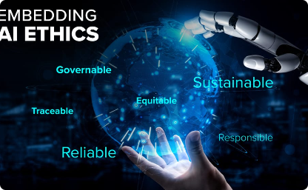
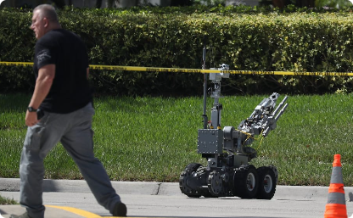
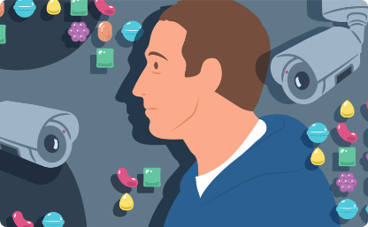
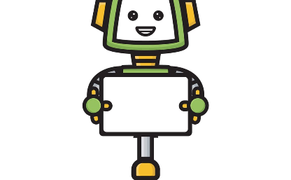
Ethical Considerations of AI
Job Displacement
Security and Privacy
AI could replace jobs traditionally done by humans, including white-collar professions, causing widespread unemployment and economic instability.
AI can pose risks to data privacy and security due to the large amounts of information it processes daily, along with the emerging threats of AI-generated deep fakes.
Human Bias
Accountability and Regulation
The AI is developed and trained by humans, so it is subjected to human bias that can perpetuate and even exacerbate prejudices and unfairness.
There is no specific governing worldwide body to regulate AI, leading to ethical concerns among industry leaders, including ways to hold AI developers accountable for their actions.

Slide 7
Future of AI
AI-Artist Collaboration
Research advancements in AI and artistic creativity will enable unconventional creativity and innovative avenues for technology-based artistic expression.
1
2
3
Quantum Supremacy
Cyborg Age
Quantum computers will enhance the speed, precision, and intelligence of AI to afford solutions to previously unsolvable problems.
Integration of AI with biological systems could make humans superhuman by extending lifespans and enhancing physical capacity and mental faculties.

