Slide 1



The Magic of Algorithms
An algorithm is a set of instructions that a computer program can follow to solve a problem or complete a task. Despite their complexity, algorithms are all around us.
by Nicholas Akakpo

Slide 2
Types of Algorithms
Searching Algorithms
Sorting Algorithms
Searches for a particular value or element in a data structure.
Organizes data in a specific order, such as ascending or descending.
Greedy Algorithms
Dynamic Programming Algorithms
Makes the locally optimal choice at each stage in hopes of finding a global optimum.
Breaks down complex problems into smaller subproblems to simplify them.

Slide 3



How Are Algorithms Developed?
Problem Identification
Planning
Implementation
The first step is to identify the problem that needs to be solved.
Develop a plan or strategy for solving the problem.
Write the code to execute the algorithm.

Slide 4
The Importance of Algorithms
1
Efficiency
Well-designed algorithms can solve problems efficiently, saving time and resources.
2
Accuracy
Algorithms are designed to follow precise instructions, leading to accurate results.
3
Consistency
Algorithms can consistently produce the same output given the input.

Slide 5

Common Algorithmic Problems
1
Traveling Salesman Problem
2
Knapsack Problem
What is the most valuable combination of items that a thief can fit into their knapsack given a weight limit?
How to find the shortest route visiting every location on a list exactly once?
3
Optimal Job Sequencing Problem
What is the best order to perform a set of jobs to minimize the total time required to complete them?

Slide 6
Real Life Examples
Google Algorithms
Netflix Algorithms
Optimizing Traffic Flow
Google's search algorithms use machine learning models to process hundreds of billions of web pages.
Netflix uses a variety of algorithms to create personalized recommendations for its users.
Cities use algorithms to control traffic flow and implement timed traffic lights.

Slide 7
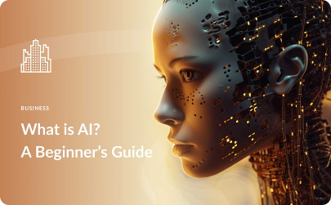

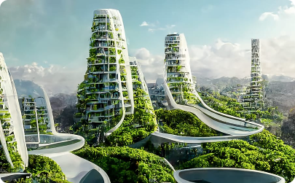
The Future of Algorithm Development
Artificial Intelligence
Quantum Computing
Smart Cities
Algorithms will continue to evolve through the implementation of AI and machine learning.
Quantum algorithms will be able to solve complex problems that classical algorithms can't.
Algorithms will be used to create smart cities, which can provide services and solve problems more efficiently.

